Slide 1
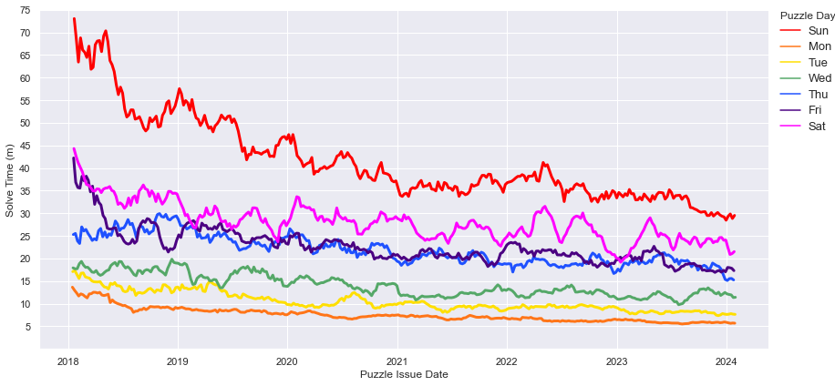
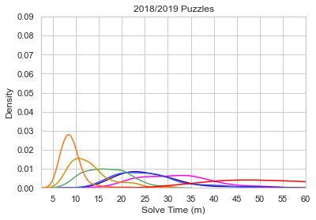
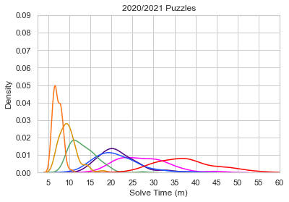
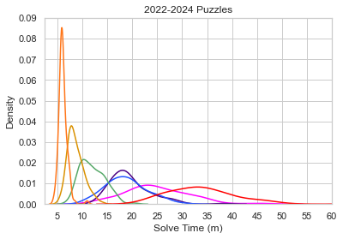
Notes:
Fig. 1 (01302024 updated)

Slide 2
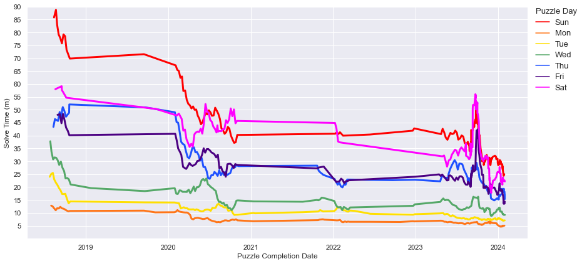
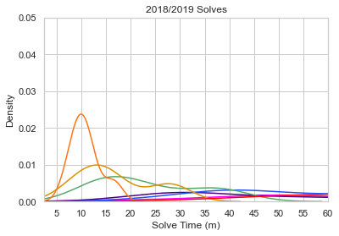
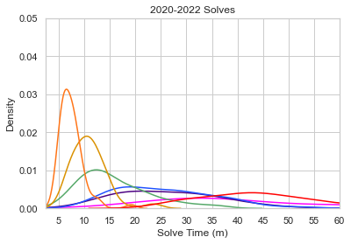
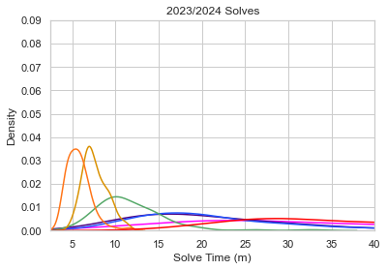
Notes:
Fig. 2

Slide 3
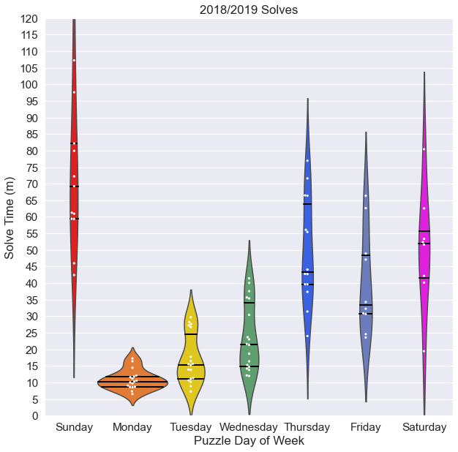
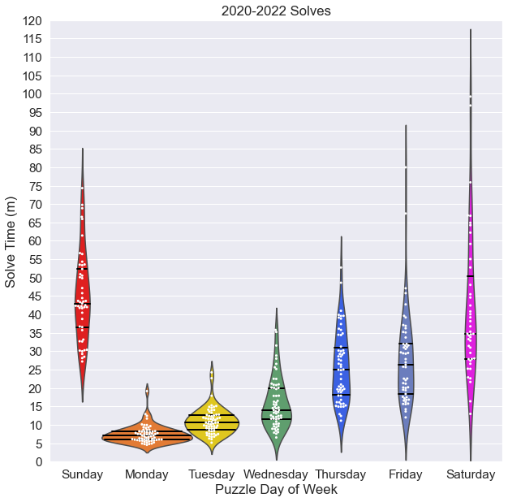
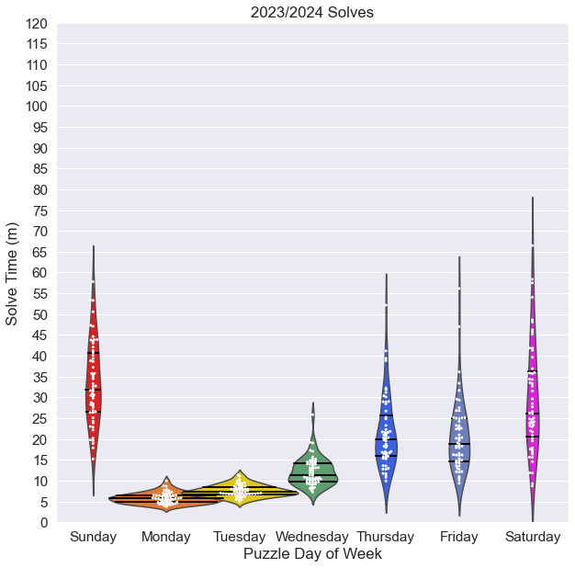
Notes:
Fig. 3 live versions

Slide 4
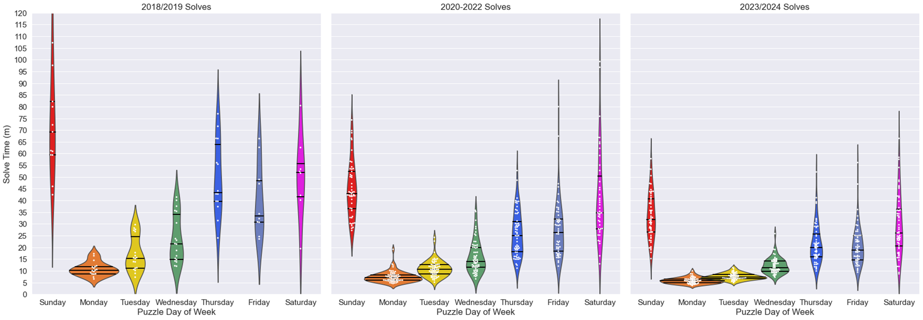
Notes:
Fig. 3 flattened version

Slide 5
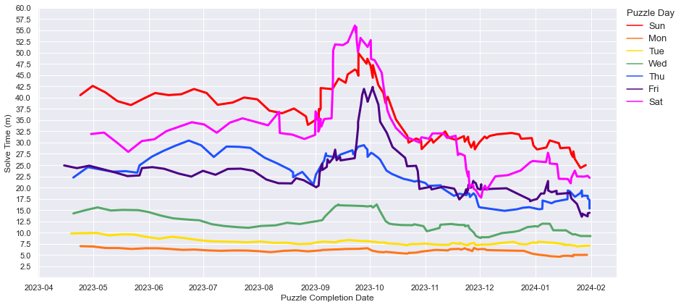
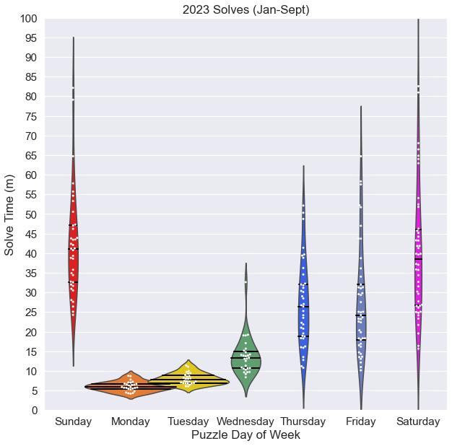
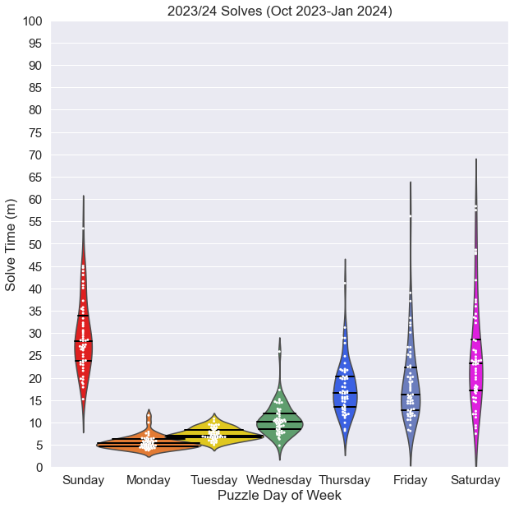
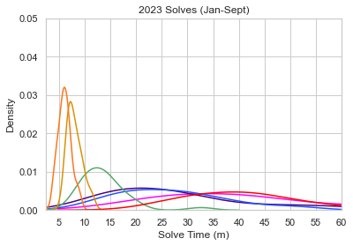
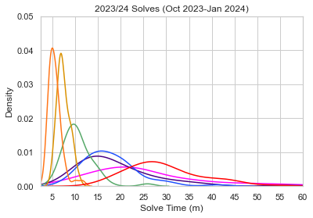
Notes:
Fig. 4 split interval

Slide 6
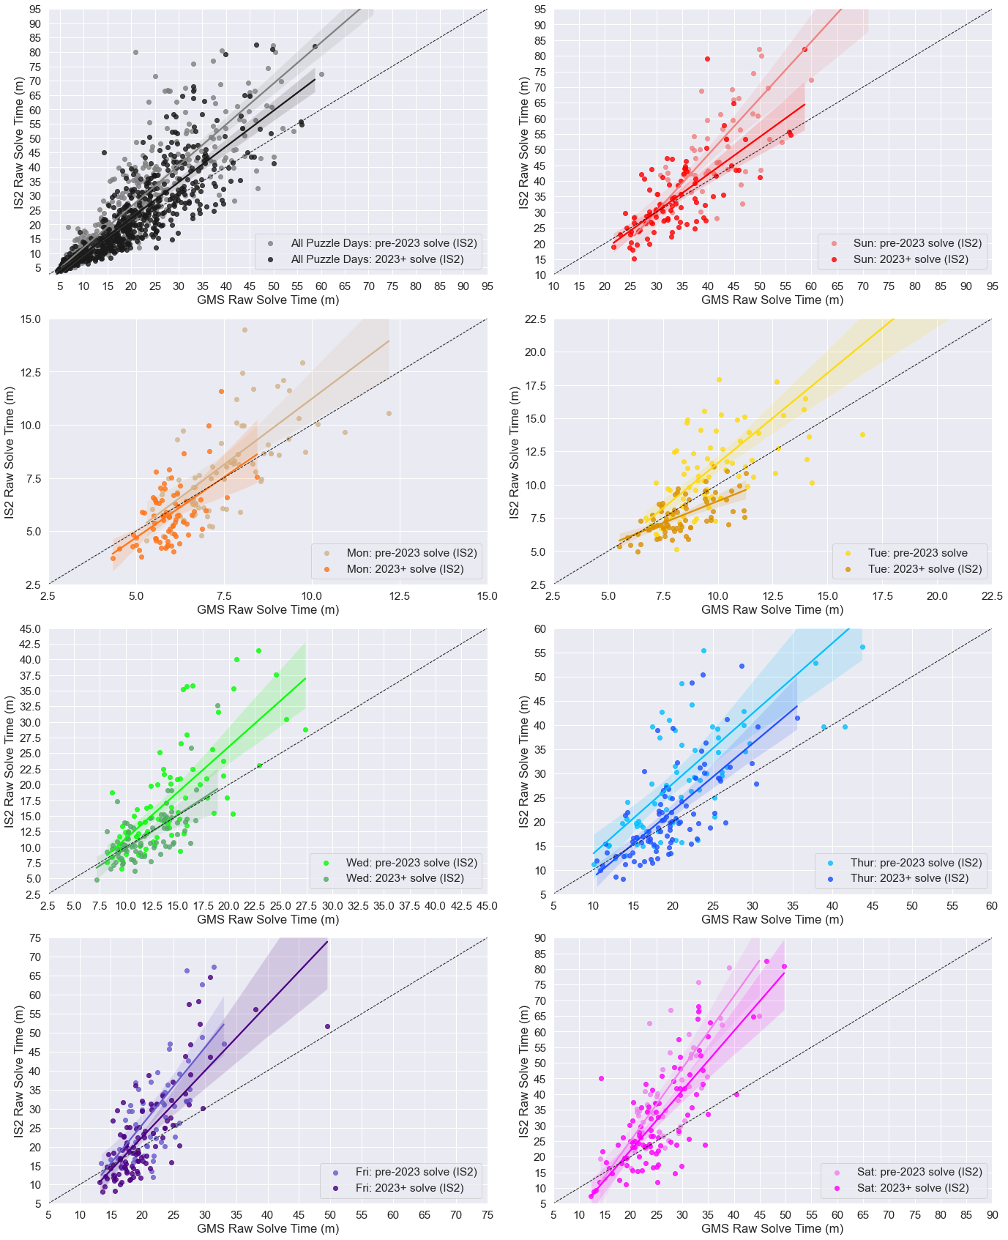
Notes:
Fig 5

Slide 7
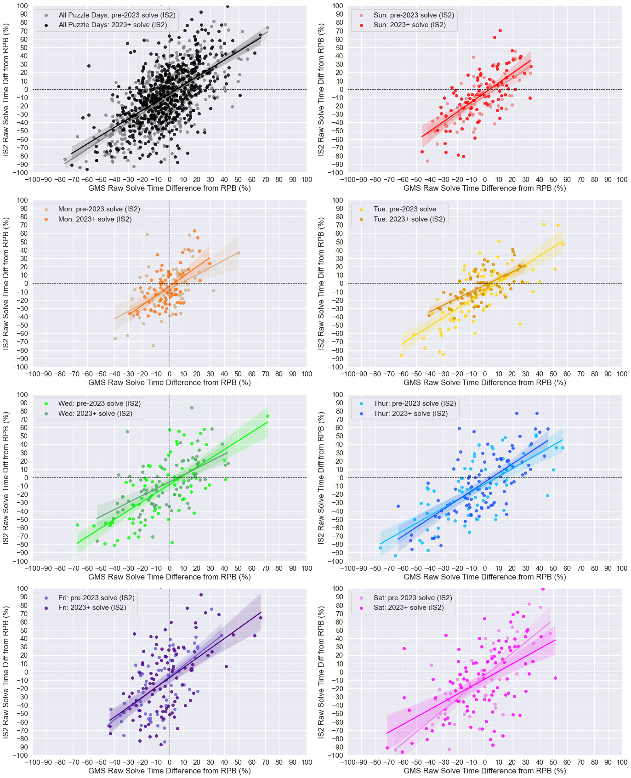
Notes:
Fig 6

Slide 8
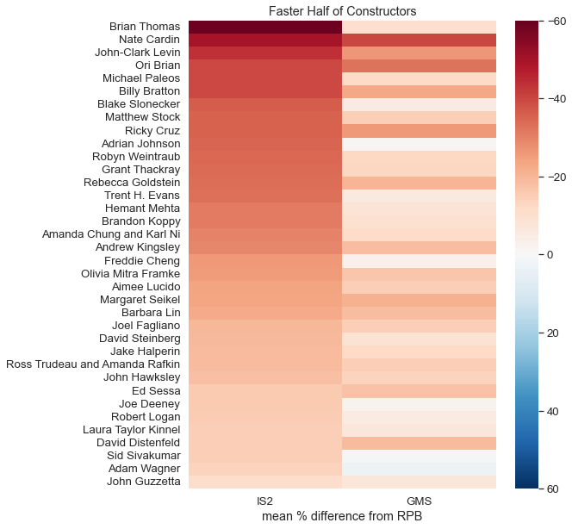
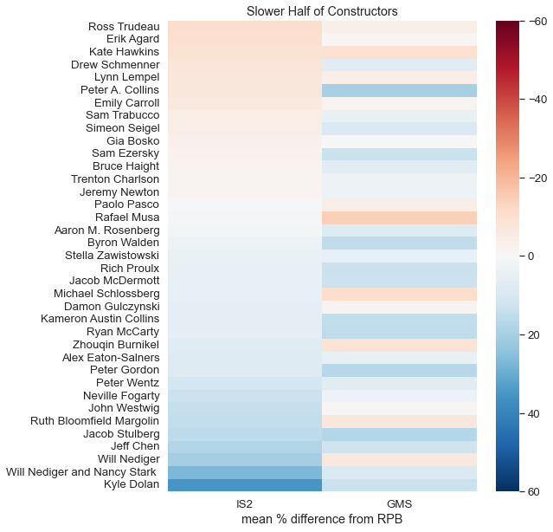
Notes:
Figure 7 live

Slide 9
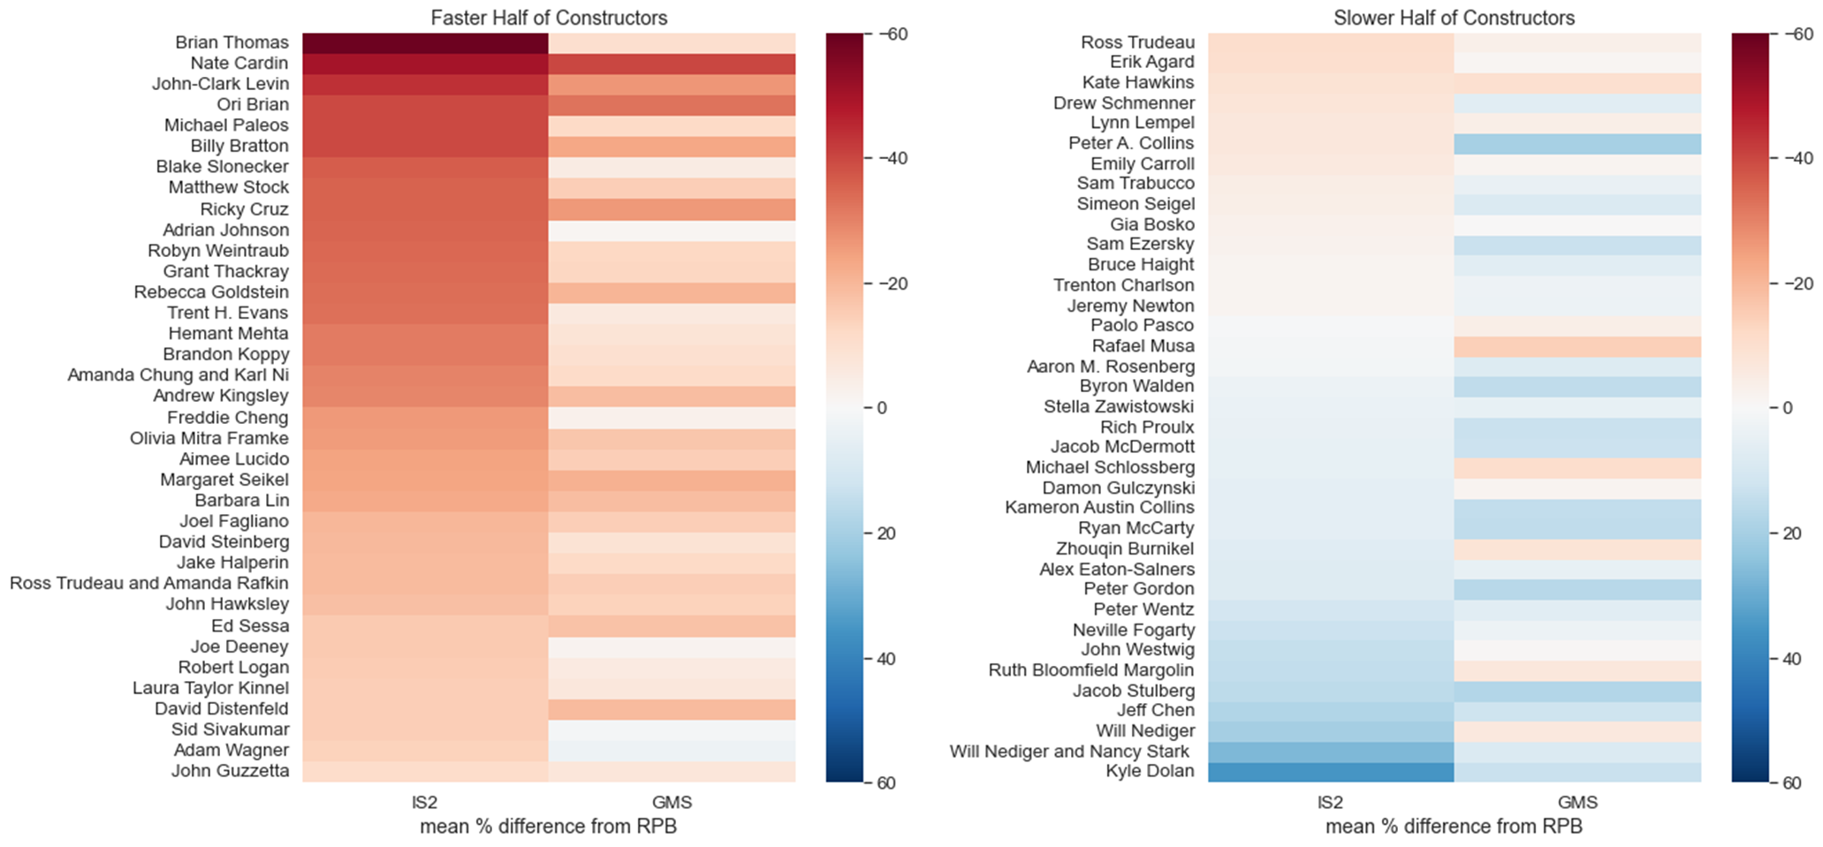
Notes:
Fig 7 flat

Slide 10
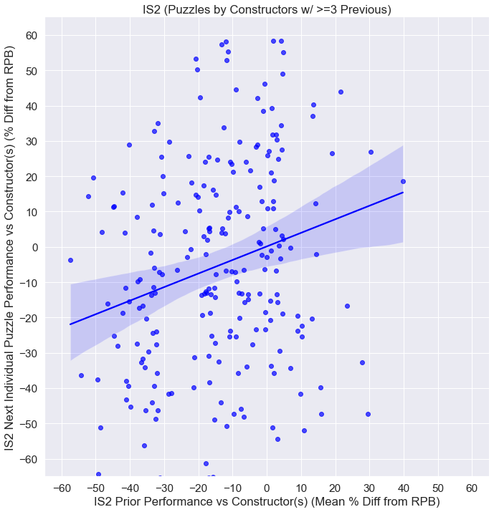
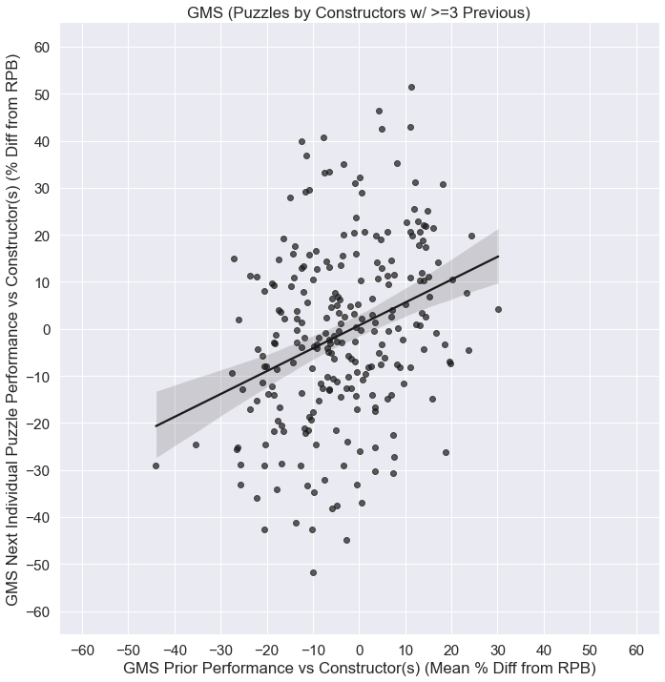
Notes:
Figure 8

Slide 11
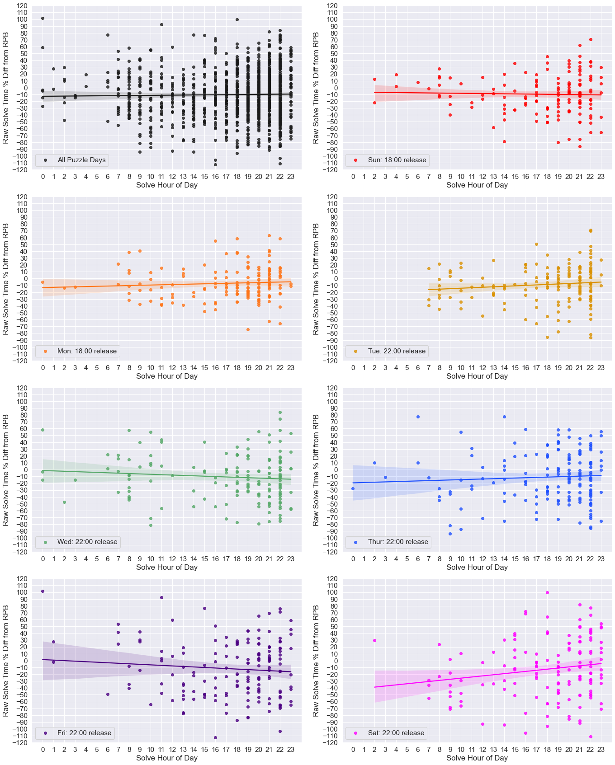
Notes:
Figure 9

Slide 12
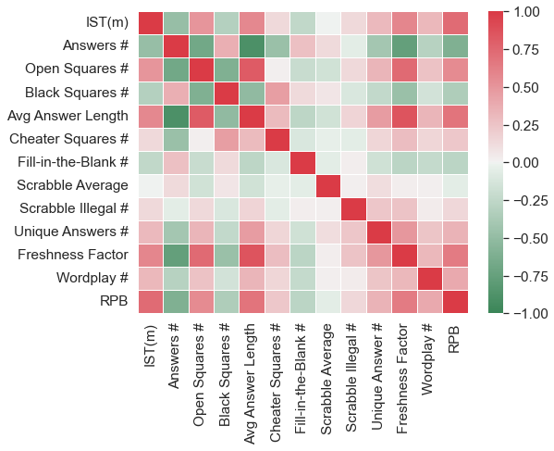
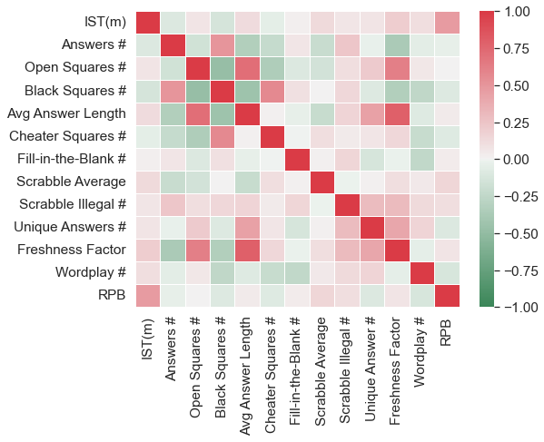
15x15 Puzzles (Mon-Sat)
21x21 Puzzles (Sun)
Clue/Answer
Content
Past
Results
Clue/Answer
Content
Past
Results
Grid Features
Grid Features
Notes:
Figure 10

Slide 13
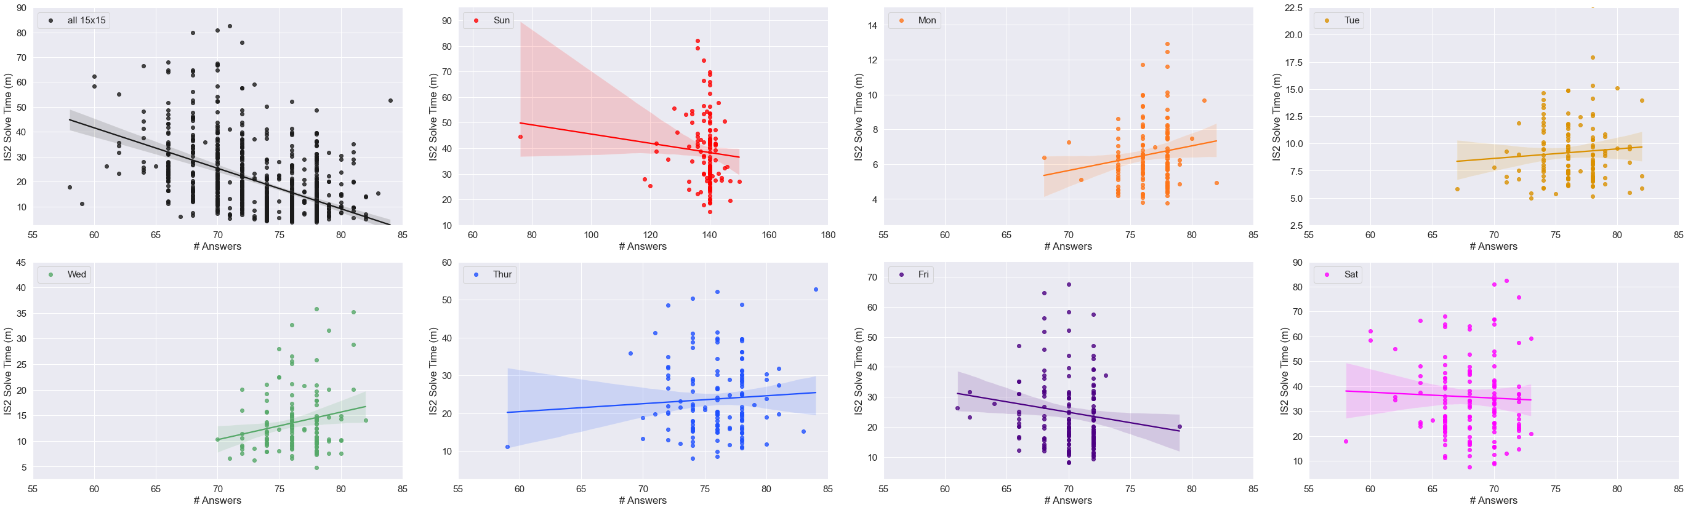
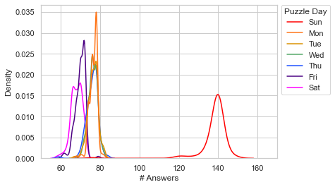
Notes:
Figure 11

Slide 14
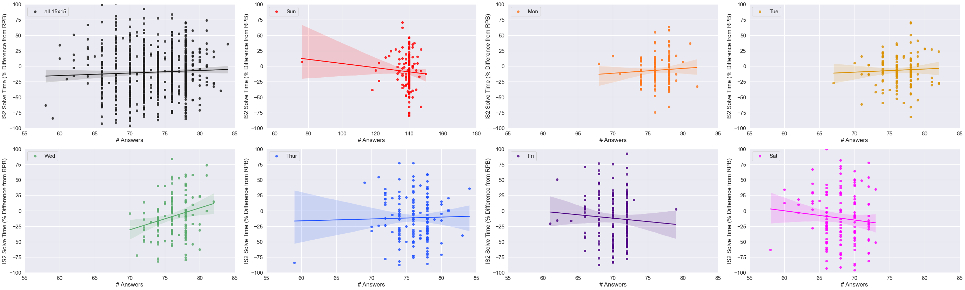
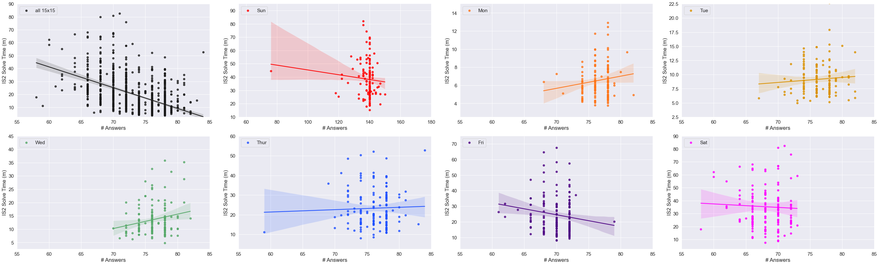
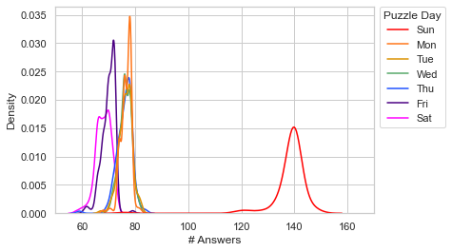
Notes:
Figure 11

Slide 15
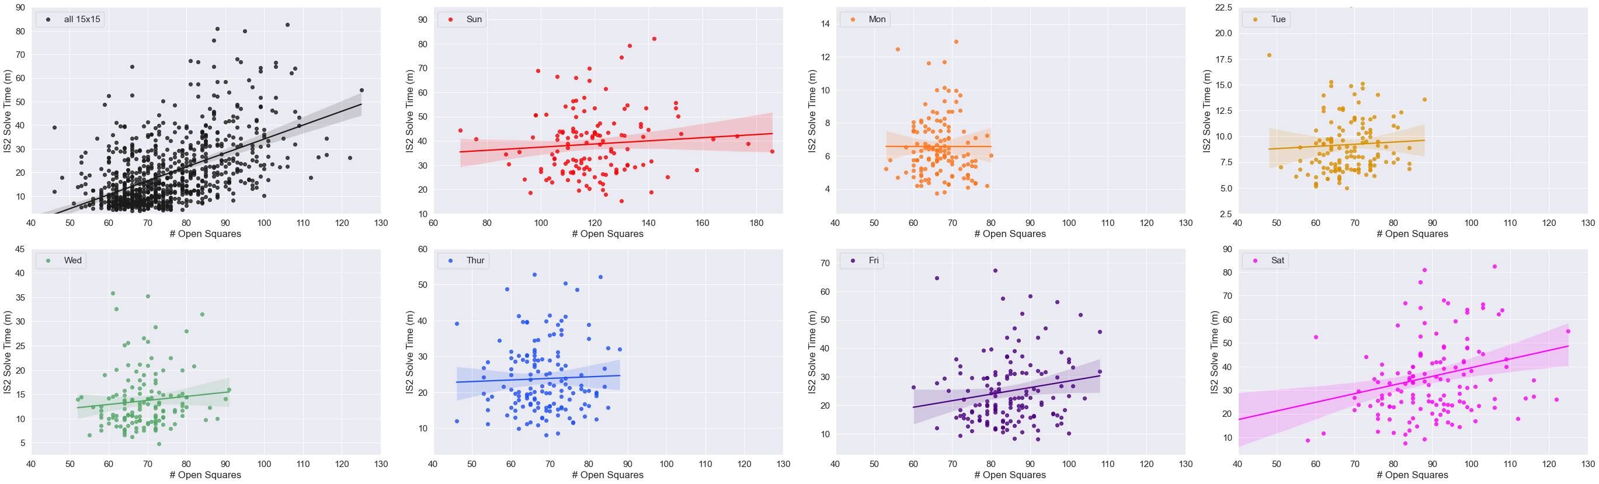
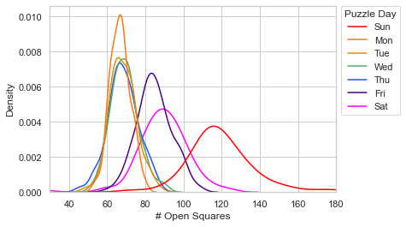
Notes:
Figure 12

Slide 16

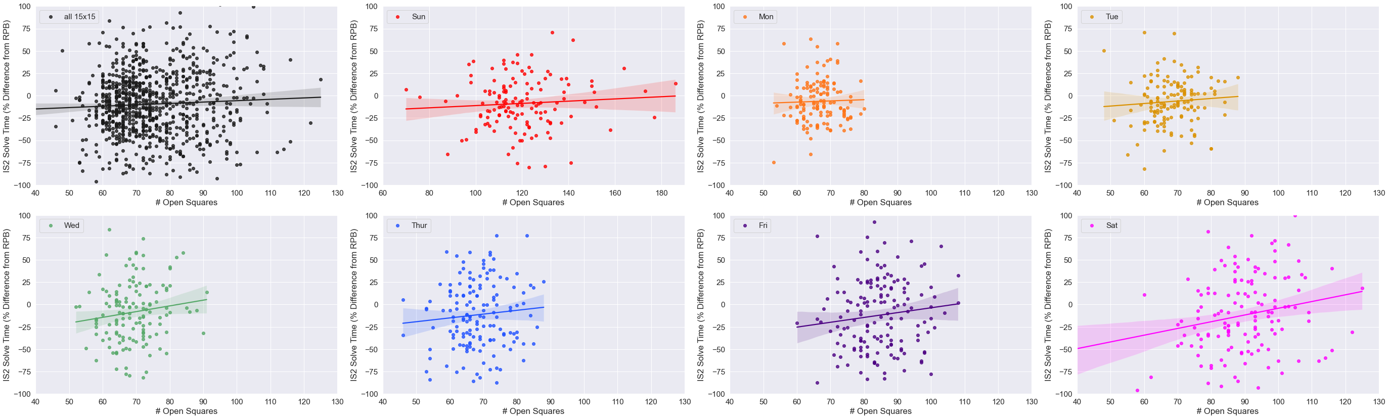
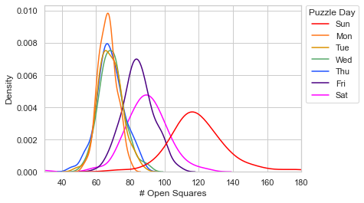
Notes:
Figure 12

Slide 17
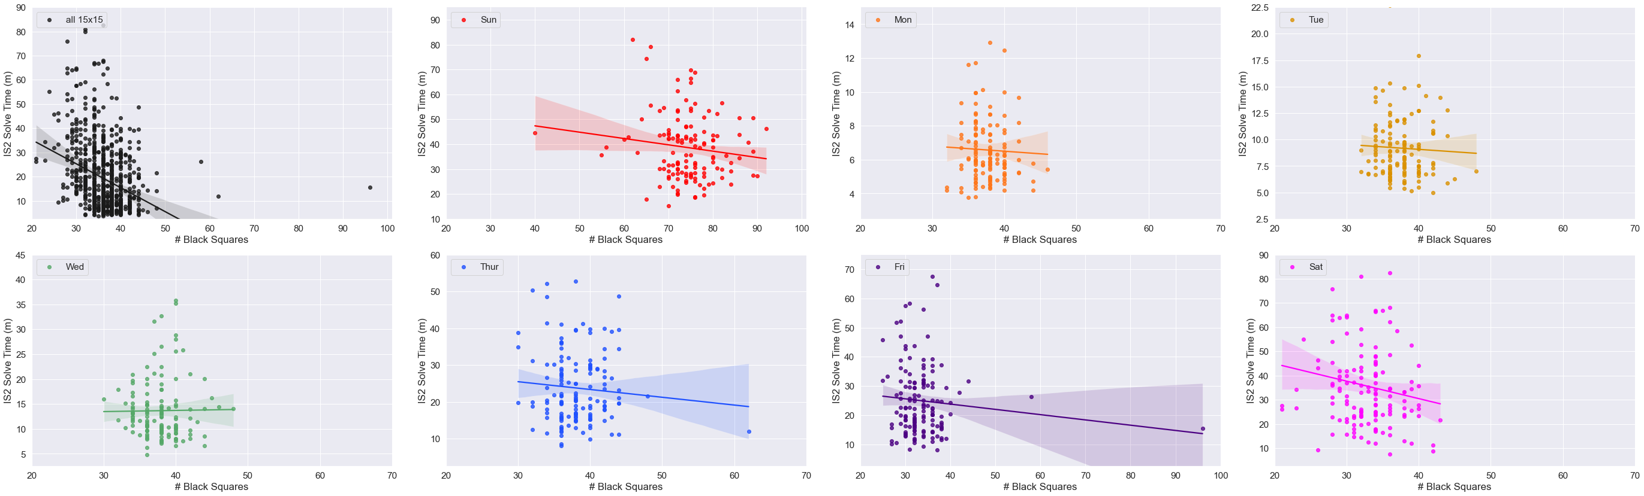
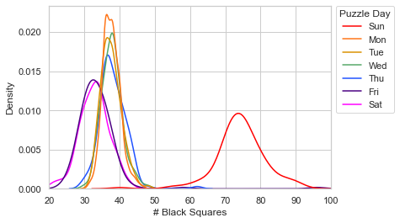
Notes:
Figure 12

Slide 18
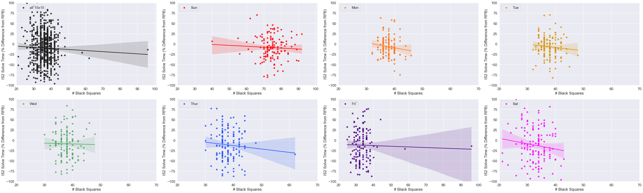
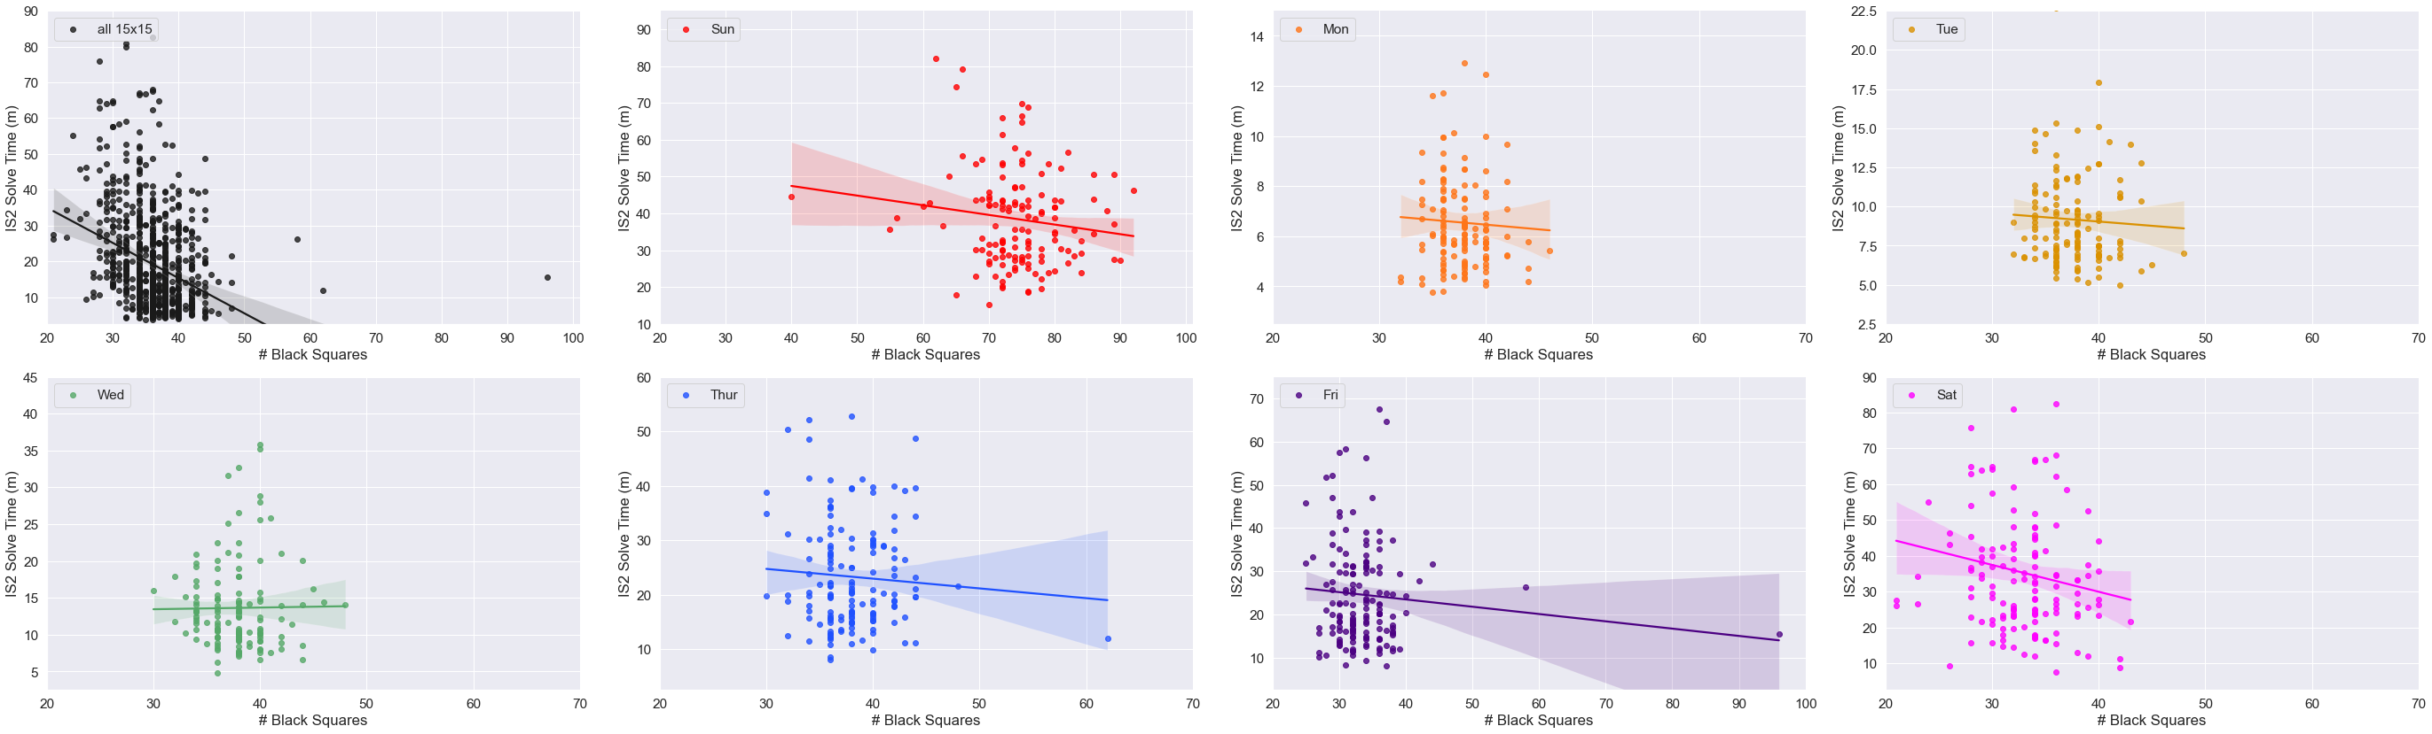
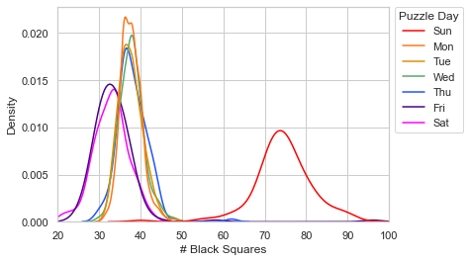
Notes:
Figure 12

Slide 19
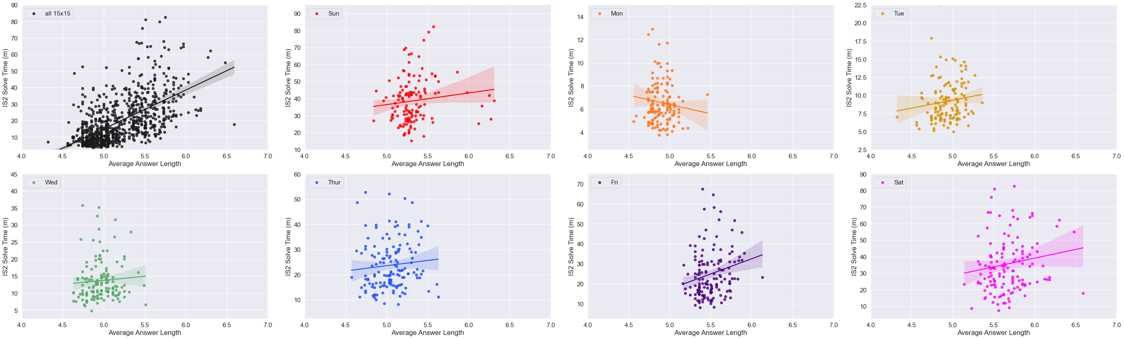
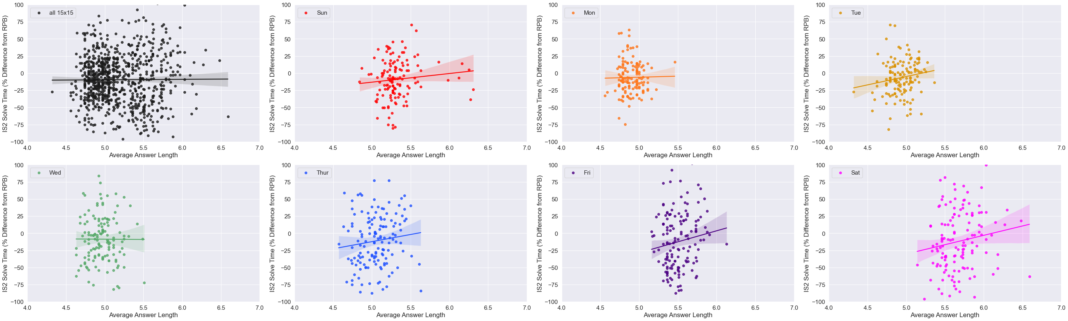
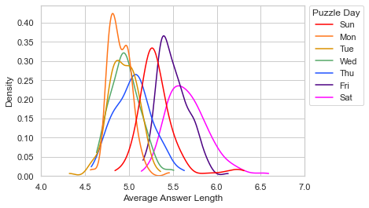
Notes:
Figure 13

Slide 20


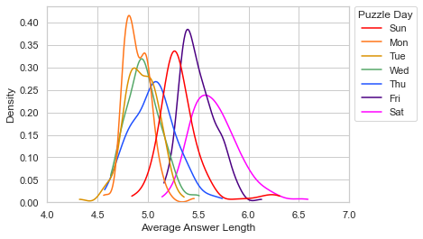
Notes:
Figure 13

Slide 21
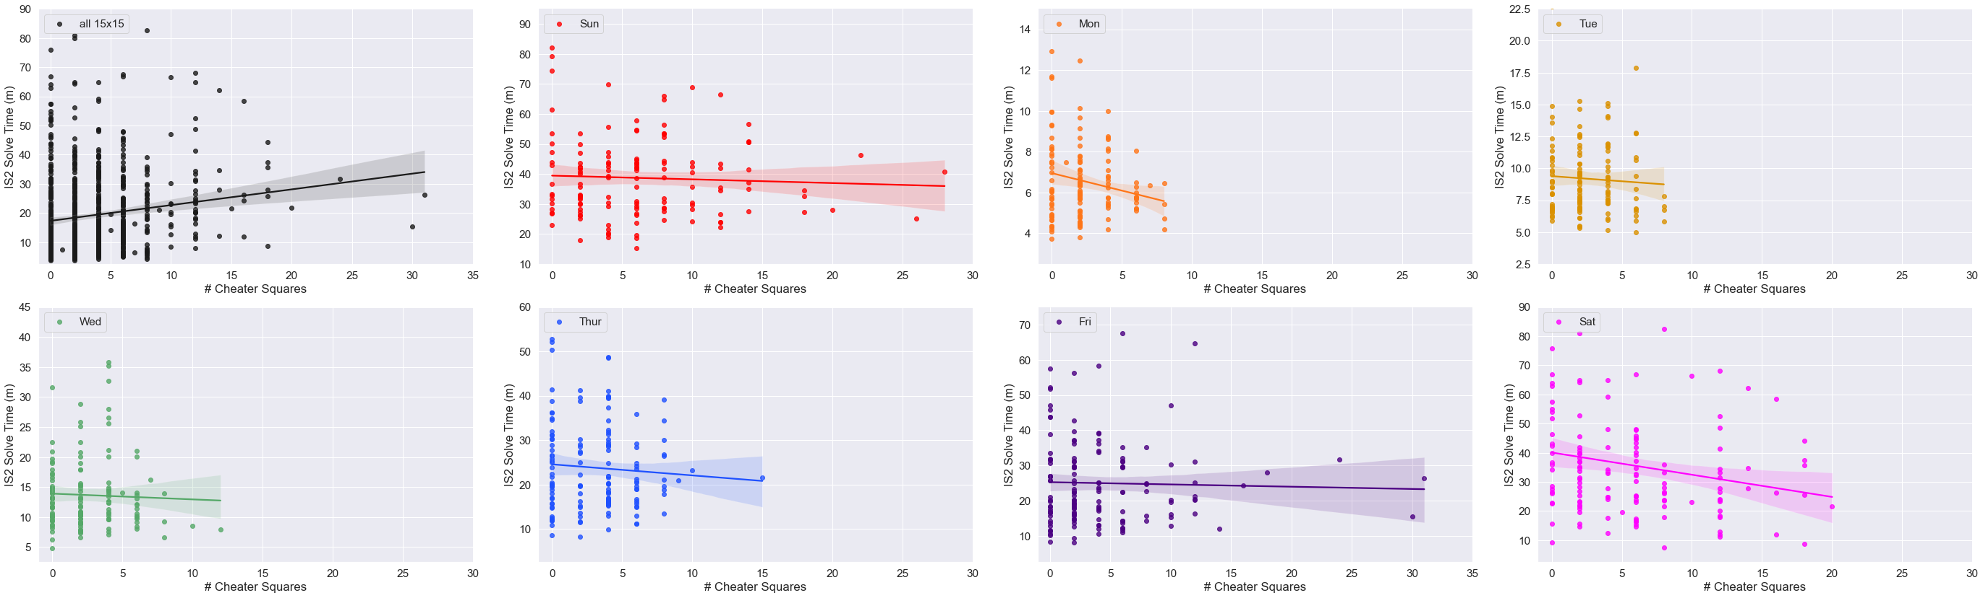
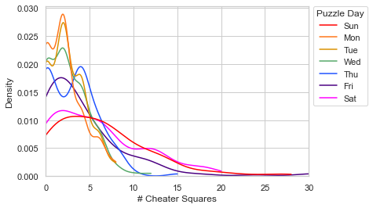
Notes:
Figure 14

Slide 22

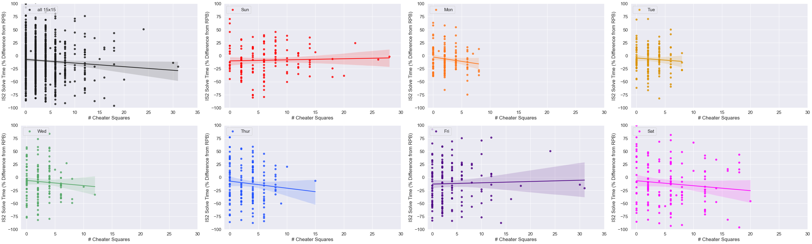
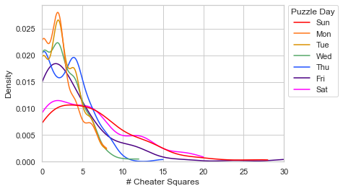
Notes:
Figure 14

Slide 23
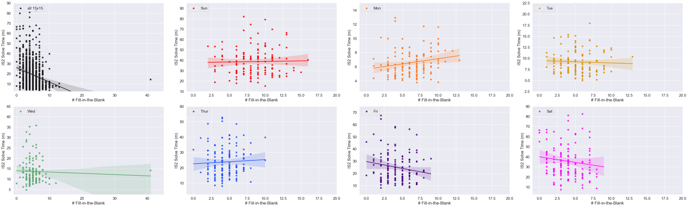

Notes:
Figure 16

Slide 24



Notes:
Figure 16

Slide 25


Notes:
Fig. 17

Slide 26



Notes:
Fig. 17

Slide 27


Notes:
Fig. 18

Slide 28



Notes:
Fig. 18

Slide 29


Notes:
Fig. 19

Slide 30



Notes:
Fig. 19

Slide 31


Notes:
Fig. 20

Slide 32



Notes:
Fig. 20

Slide 33


Notes:
Fig. 21

Slide 34



Notes:
Fig. 21

Slide 35

Notes:
Fig. 22

Slide 36
Data Supplement

Slide 37

Notes:
Supplementary Figure 1

Slide 38






Monday
Tuesday
Wednesday
Thursday
Friday
Saturday
Notes:
Supp. Fig. 2 live version

Slide 39


Notes:
Supp. Fig. 2 flat version

Slide 40


Notes:
Supplementary Figure 2

Slide 41


Notes:
Supplementary Figure 2

Slide 42

Notes:
Supplementary Figure 3

Slide 43


Notes:
Supplementary Figure 3

Slide 44


Notes:
Supplementary Figure 4

Slide 45


Notes:
Supplementary Figure 4

